Slide 1
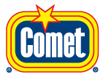
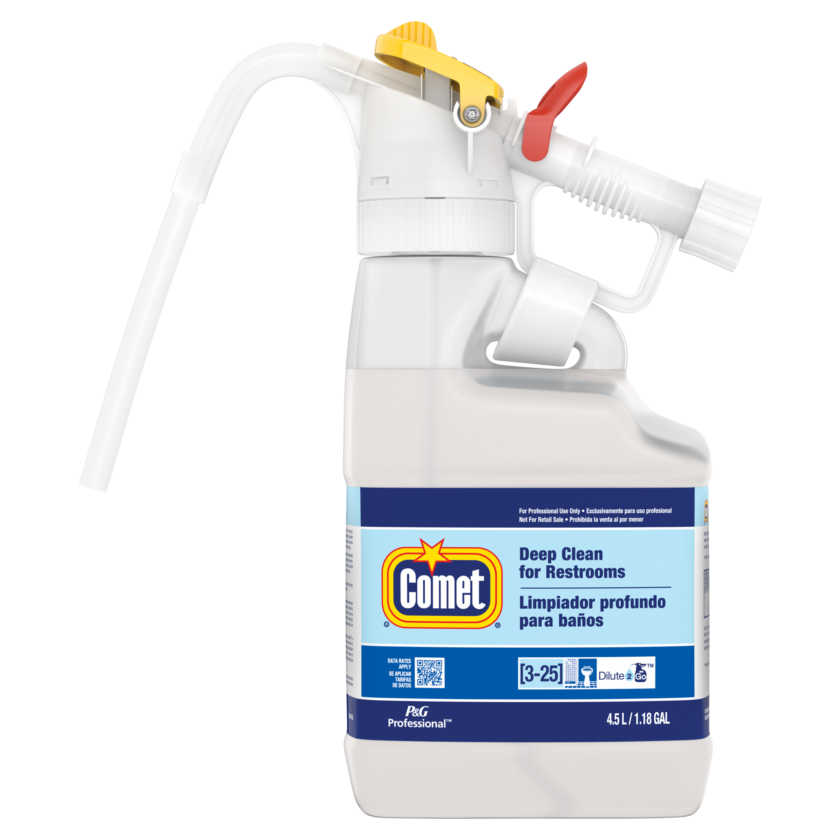
Dilute2Go
Comet® Deep Clean
For Restrooms
Comet Deep Clean removes soap scum, greasy soil, delivering a noticeable clean versus the leading competitor
Features
No direct contact with concentrated chemicals
No free pour or wall mounted equipment needed
Accurate dilution ratio
Easy to use slide bar – select between product and water for diluting or rinsing
Removes soap scum, delivering a noticeable clean*
Works great on toilets and sinks
Effectively removes greasy soils and soap scum*
Task Areas
Customer and Employee Restrooms, Tile, Chrome
Toilets
Urinals
Sinks/counter tops/fixtures
Shower walls
Tubs
Soap scum
Hard water stains
Size | Description | Dilution | Case UPC
4.5L | Comet Deep Clean Restroom Cleaner Dilute2Go | 1:14 | 10037000866784
4.5L Dilute 2 Go
Fills up to 70 32oz. spray bottles
* vs. leading competitor
For more information call 1-800-332-7787 or visit www.pgpro.com

