Slide 1
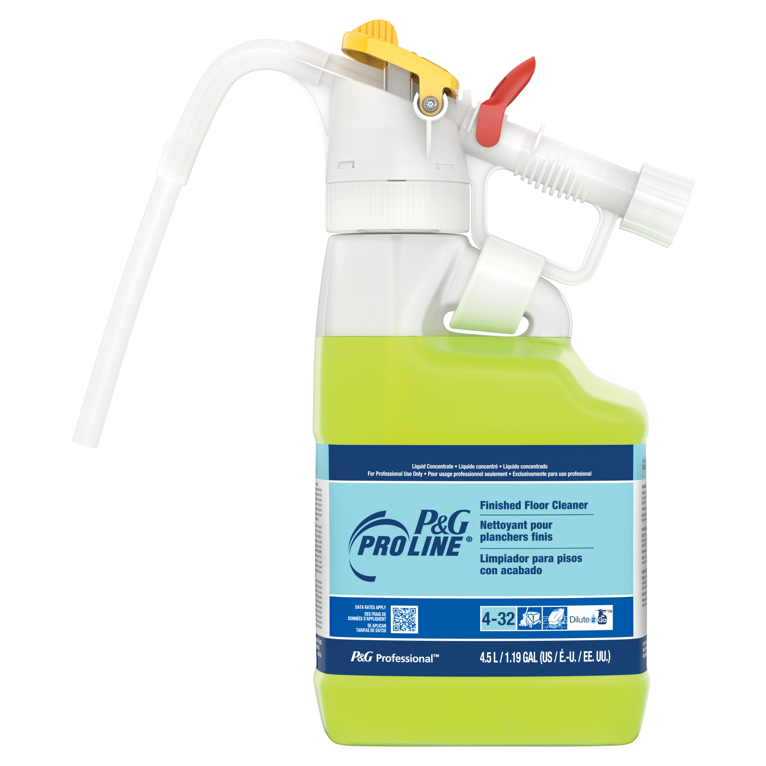
Dilute2Go
P&G Pro Line® Finished Floor Cleaner
Cleans to the shine and works to dissolve and remove tough ground-in dirt from finished floors, without leaving a dulling residue. Delivers shine and extends time between strips, by effectively removing grimy soils. Low sudsing, making it an excellent choice for use in automatic scrubbing machines.
Features
No direct contact with concentrated chemicals
Accurate dilution ratio
No free pour or wall mounted equipment needed
Easy to use slide bar – select between product and water for diluting or rinsing
Removes dirt, grease, and particulate soils, without hurting the finish – prolonging the life of the floor finish
Formulated to be safe on finished floors
Low sudsing
Low/no residue
Cost-effective – Designed to work well when highly diluted
Clean fresh scent
Task Areas
Floors
VCT
Ceramic tile
Vinyl tile
Terrazzo
Stone
Finished hardwood
Size | Description | Dilution | UPC
4.5L | P&G Pro Line Finished Floor Cleaner #32 D2G | 1:256 | 10037000720031
4.5L Dilute 2 Go
Fills up 76 4-gallon buckets
For more information call 1-800-332-7787 or visit www.pgpro.com

